Slide 1
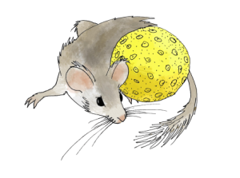
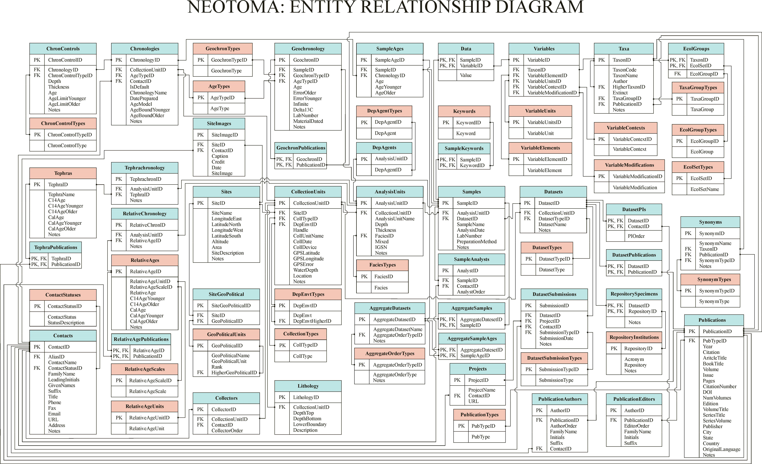
Neotoma Database Structure

Slide 2
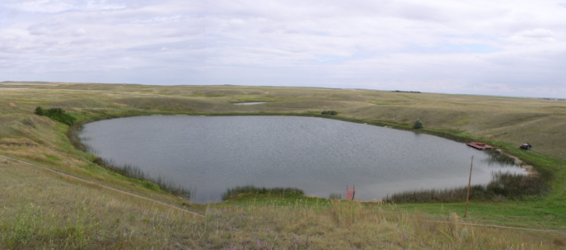
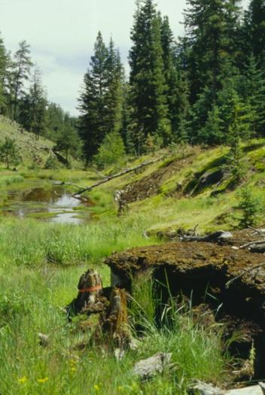
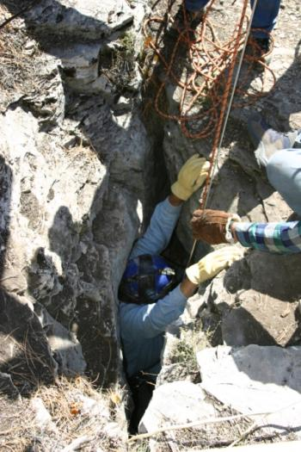
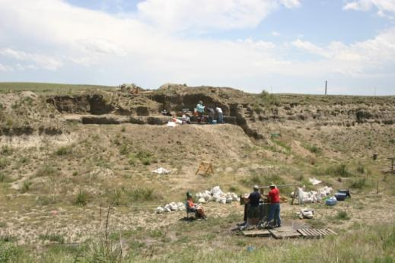
Sites
Sites Table
Kettle Lake
SiteID
SiteName
LongitudeEast
LatitudeNorth
LongitudeWest
LatitudeSouth
Altitude
Area
SiteDescription
Notes
Iron Hills
Parkers Pit
Kanarado

Slide 3
Collection Units
Sites
CollectionUnits
SiteID
SiteName
LongitudeEast
LatitudeNorth
LongitudeWest
LatitudeSouth
Altitude
Area
SiteDescription
Notes
CollectionUnitID
SiteID
CollTypeID
DepEnvtID
Handle
CollUnitName
CollDate
CollDevice
GPSLatitude
GPSLongitude
GPSError
WaterDepth
Location
Notes

Slide 4
Collection Units
CollectionUnits
CollectionTypes
CollectionUnitID
SiteID
CollTypeID
DepEnvtID
Handle
CollUnitName
CollDate
CollDevice
GPSLatitude
GPSLongitude
GPSError
WaterDepth
Location
Notes
CollTypeID
CollType
Animal midden
Composite
Core
Excavation
Modern
Section
Surface float
Isolated specimen

Slide 5
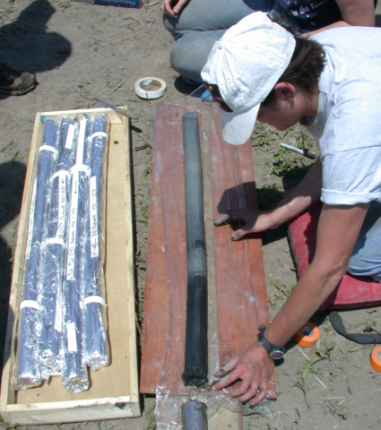
Collection Units
CollectionUnits
CollectionTypes
CollectionUnitID
SiteID
CollTypeID
DepEnvtID
Handle
CollUnitName
CollDate
CollDevice
GPSLatitude
GPSLongitude
GPSError
WaterDepth
Location
Notes
CollTypeID
CollType
Animal midden
Composite
Core
Excavation
Modern
Section
Surface float
Isolated specimen

Slide 6
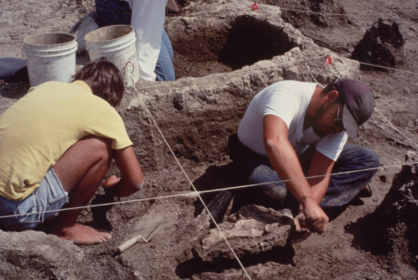
Collection Units
CollectionUnits
CollectionTypes
CollectionUnitID
SiteID
CollTypeID
DepEnvtID
Handle
CollUnitName
CollDate
CollDevice
GPSLatitude
GPSLongitude
GPSError
WaterDepth
Location
Notes
CollTypeID
CollType
Animal midden
Composite
Core
Excavation
Modern
Section
Surface float
Isolated specimen

Slide 7
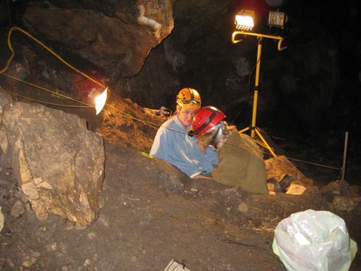
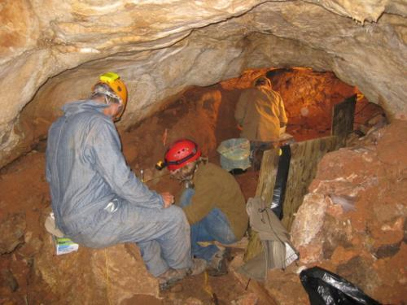
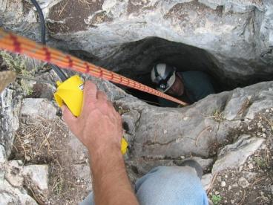
Collection Units
CollectionUnits
CollectionTypes
Parker’s Pit
CollectionUnitID
SiteID
CollTypeID
DepEnvtID
Handle
CollUnitName
CollDate
CollDevice
GPSLatitude
GPSLongitude
GPSError
WaterDepth
Location
Notes
CollTypeID
CollType
Main Cone
Animal midden
Composite
Core
Excavation
Modern
Section
Surface float
Isolated specimen
Red Cone

Slide 8
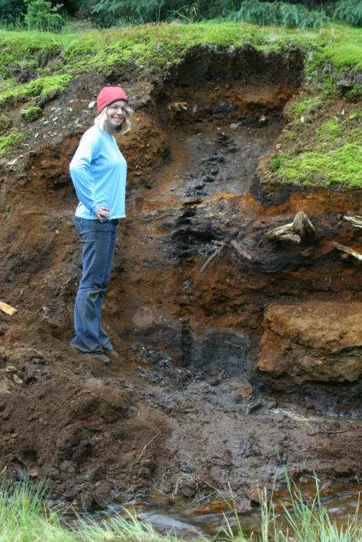
Collection Units
CollectionUnits
CollectionTypes
CollectionUnitID
SiteID
CollTypeID
DepEnvtID
Handle
CollUnitName
CollDate
CollDevice
GPSLatitude
GPSLongitude
GPSError
WaterDepth
Location
Notes
CollTypeID
CollType
Animal midden
Composite
Core
Excavation
Modern
Section
Surface float
Isolated specimen

Slide 9
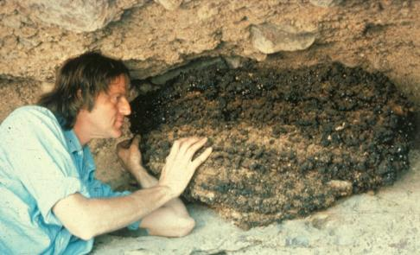
Collection Units
CollectionUnits
CollectionTypes
CollectionUnitID
SiteID
CollTypeID
DepEnvtID
Handle
CollUnitName
CollDate
CollDevice
GPSLatitude
GPSLongitude
GPSError
WaterDepth
Location
Notes
CollTypeID
CollType
Animal midden
Composite
Core
Excavation
Modern
Section
Surface float
Isolated specimen

Slide 10
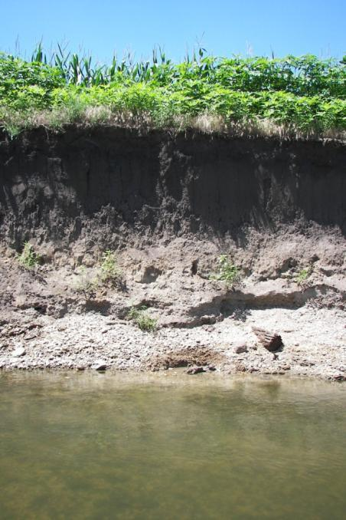
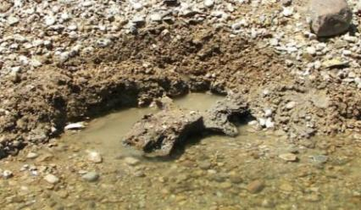
Collection Units
CollectionUnits
CollectionTypes
CollectionUnitID
SiteID
CollTypeID
DepEnvtID
Handle
CollUnitName
CollDate
CollDevice
GPSLatitude
GPSLongitude
GPSError
WaterDepth
Location
Notes
CollTypeID
CollType
Animal midden
Composite
Core
Excavation
Modern
Section
Surface float
Isolated specimen
Fraxinus
Mammuthus primigenius right maxilla and malar

Slide 11
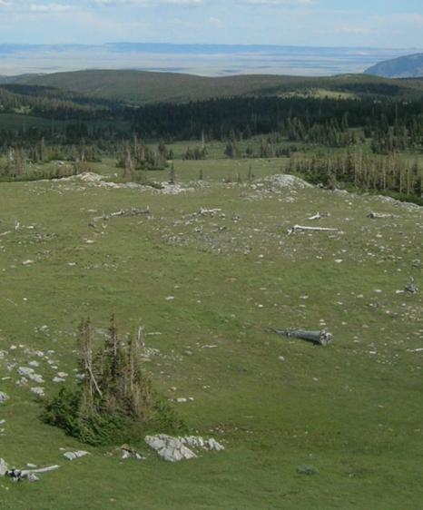
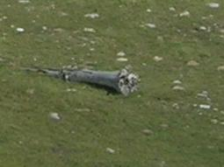
Collection Units
CollectionUnits
CollectionTypes
CollectionUnitID
SiteID
CollTypeID
DepEnvtID
Handle
CollUnitName
CollDate
CollDevice
GPSLatitude
GPSLongitude
GPSError
WaterDepth
Location
Notes
CollTypeID
CollType
Animal midden
Composite
Core
Excavation
Modern
Section
Surface float
Isolated specimen

Slide 12
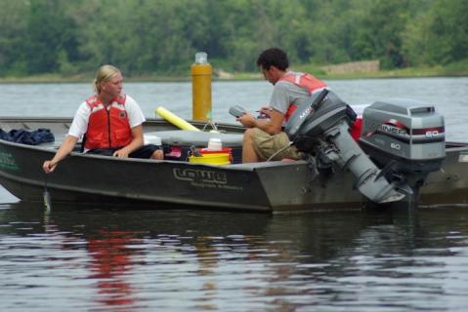
Collection Units
CollectionUnits
CollectionTypes
CollectionUnitID
SiteID
CollTypeID
DepEnvtID
Handle
CollUnitName
CollDate
CollDevice
GPSLatitude
GPSLongitude
GPSError
WaterDepth
Location
Notes
CollTypeID
CollType
Animal midden
Composite
Core
Excavation
Modern
Section
Surface float
Isolated specimen

Slide 13
Collection Units
CollectionUnits
CollectionTypes
CollectionUnitID
SiteID
CollTypeID
DepEnvtID
Handle
CollUnitName
CollDate
CollDevice
GPSLatitude
GPSLongitude
GPSError
WaterDepth
Location
Notes
CollTypeID
CollType
Animal midden
Composite
Core
Excavation
Modern
Section
Surface float
Isolated specimen

Slide 14
Depositional Environments
CollectionUnits
DepEnvtTypes
CollectionUnitID
SiteID
CollTypeID
DepEnvtID
Handle
CollUnitName
CollDate
CollDevice
GPSLatitude
GPSLongitude
GPSError
WaterDepth
Location
Notes
DepEnvtD
DepEnvt
DepEnvtHigherID
Archaeological
Biological
Estuarine
Lacustrine
Palustrine
Riverine
Sampler
Spring
Terrestrial
Animal Midden
Packrat (Neotoma) Midden
Natural Lake
Glacial Origin Lake
Kettle Lake
Mire
Bog
Blanket Bog
Pollen Trap
Pollen Trap (Terrestrial)
Tauber Trap
Aeolian
Loess
Dune
Cave
Pit Cave

Slide 15
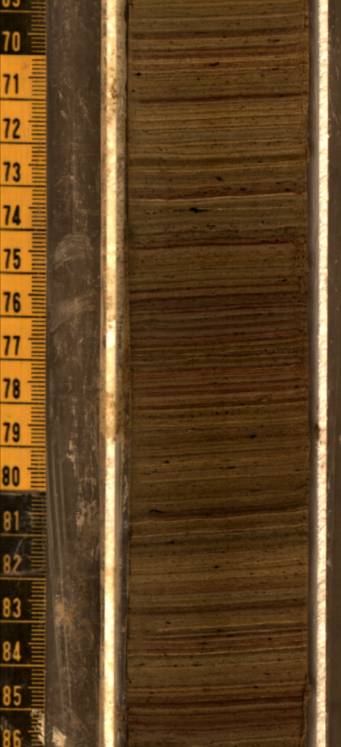
Analysis Units
CollectionUnits
AnalysisUnits
CollectionUnitID
SiteID
CollTypeID
DepEnvtID
Handle
CollUnitName
CollDate
CollDevice
GPSLatitude
GPSLongitude
GPSError
WaterDepth
Location
Notes
AnalysisUnitID
CollectionUnitID
AnalysisUnitName
Depth
Thickness
FaciesID
Mixed
IGSN
Notes

Slide 16
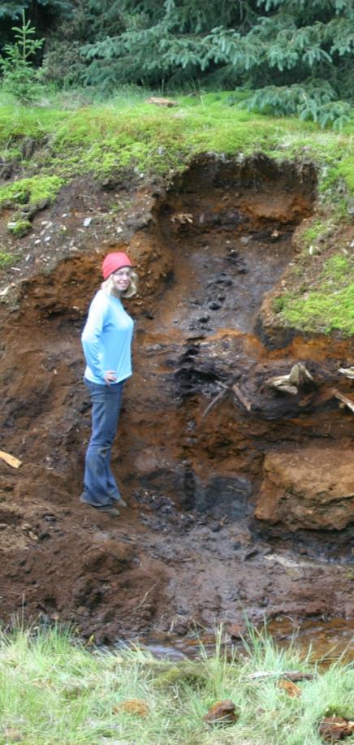
Analysis Units
CollectionUnits
AnalysisUnits
CollectionUnitID
SiteID
CollTypeID
DepEnvtID
Handle
CollUnitName
CollDate
CollDevice
GPSLatitude
GPSLongitude
GPSError
WaterDepth
Location
Notes
AnalysisUnitID
CollectionUnitID
AnalysisUnitName
Depth
Thickness
FaciesID
Mixed
IGSN
Notes

Slide 17
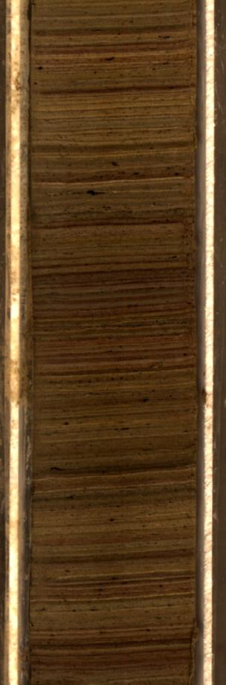
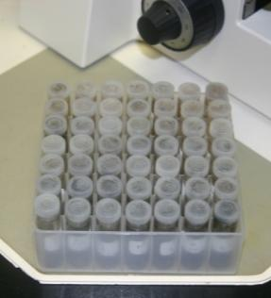
Samples
AnalysisUnits
Samples
AnalysisUnitID
CollectionUnitID
AnalysisUnitName
Depth
Thickness
FaciesID
Mixed
IGSN
Notes
SampleID
AnalysisUnitID
DatasetID
SampleName
AnalysisDate
LabNumber
PreparationMethod
Notes
Pollen
Charcoal
Diatoms
Loss-on-ignition

Slide 18
Datasets
Samples
Datasets
DatasetTypes
SampleID
AnalysisUnitID
DatasetID
SampleName
AnalysisDate
LabNumber
PreparationMethod
Notes
DatasetID
CollectionUnitID
DatasetTypeID
DatasetName
Notes
DatasetTypeID
DatasetType
geochronologic
loss-on-ignition
pollen
plant macrofossils
vertebrate fauna
mollusks
pollen surface sample

Slide 19
Neotoma Database Structure
Sites
CollectionUnits
AnalysisUnits
Samples
Datasets
SiteID
SiteName
LongitudeEast
LatitudeNorth
LongitudeWest
LatitudeSouth
Altitude
Area
SiteDescription
Notes
CollectionUnitID
SiteID
CollTypeID
DepEnvtID
Handle
CollUnitName
CollDate
CollDevice
GPSLatitude
GPSLongitude
GPSError
WaterDepth
Location
Notes
AnalysisUnitID
CollectionUnitID
AnalysisUnitName
Depth
Thickness
FaciesID
Mixed
IGSN
Notes
SampleID
AnalysisUnitID
DatasetID
SampleName
AnalysisDate
LabNumber
PreparationMethod
Notes
DatasetID
CollectionUnitID
DatasetTypeID
DatasetName
Notes

Slide 20
Neotoma Database Structure
Sites
CollectionUnits
AnalysisUnits
Samples
Data
SiteID
SiteName
LongitudeEast
LatitudeNorth
LongitudeWest
LatitudeSouth
Altitude
Area
SiteDescription
Notes
CollectionUnitID
SiteID
CollTypeID
DepEnvtID
Handle
CollUnitName
CollDate
CollDevice
GPSLatitude
GPSLongitude
GPSError
WaterDepth
Location
Notes
AnalysisUnitID
CollectionUnitID
AnalysisUnitName
Depth
Thickness
FaciesID
Mixed
IGSN
Notes
SampleID
AnalysisUnitID
DatasetID
SampleName
AnalysisDate
LabNumber
PreparationMethod
Notes
SampleID
VariableID
Value
Datasets
DatasetID
CollectionUnitID
DatasetTypeID
DatasetName
Notes

Slide 21
Variables
Samples
Data
Variables
SampleID
AnalysisUnitID
DatasetID
SampleName
AnalysisDate
LabNumber
PreparationMethod
Notes
SampleID
VariableID
Value
VariableID
TaxonID
VariableElementID
VariableUnitsID
VariableContextID

Slide 22
Variables
Variables
Taxa
VariableID
TaxonID
VariableElementID
VariableUnitsID
VariableContextID
TaxonID
TaxonCode
TaxonName
Author
HigherTaxonID
Extinct
TaxaGroupID
PublicationID
Notes

Slide 23
Variables
Variables
VariableElements
VariableID
TaxonID
VariableElementID
VariableUnitsID
VariableContextID
VariableElementID
VariableElement
achene
acorn
acorn cup
ament bract
anther
bark
bract
bud
bud scale
bulbil
calyx
capsule
pollen
spore
stomate

Slide 24
Variables
Variables
VariableUnits
VariableID
TaxonID
VariableElementID
VariableUnitsID
VariableContextID
VariableUnitsID
VariableUnit
MNI
NISP
number
number/ml
particles/ml
percent
percent after LOI
percent dry mass
present/absent

Slide 25
Variables
Variables
VariableContexts
VariableID
TaxonID
VariableElementID
VariableUnitsID
VariableContextID
VariableContextID
VariableContext
anachronic
articulated
derived
intrusive
redeposited
clump

Slide 26
Chronologies and Age Models
An Age Model has two components:
Set of age-depth values (or analysis unit ages)
An algorithm for interpolating ages to analysis units between the ones with independent ages.

Slide 27
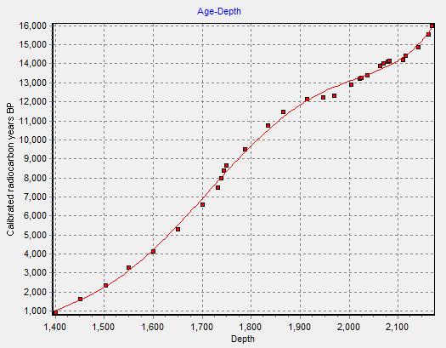
Chronologies and Age Models
An Age Model has two components:
Set of age-depth values (or analysis unit ages)
An algorithm for interpolating ages to analysis units between the ones with independent ages.
5th degree
polynomial

Slide 28
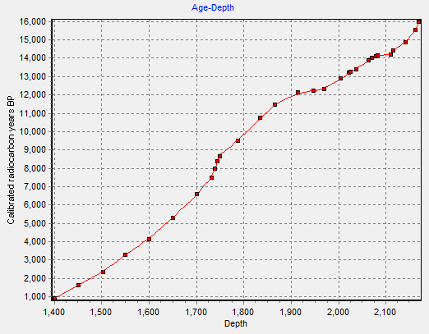
Chronologies and Age Models
An Age Model has two components:
Set of age-depth values (or analysis unit ages)
An algorithm for interpolating ages to analysis units between the ones with independent ages.
Cubic B-spline

Slide 29
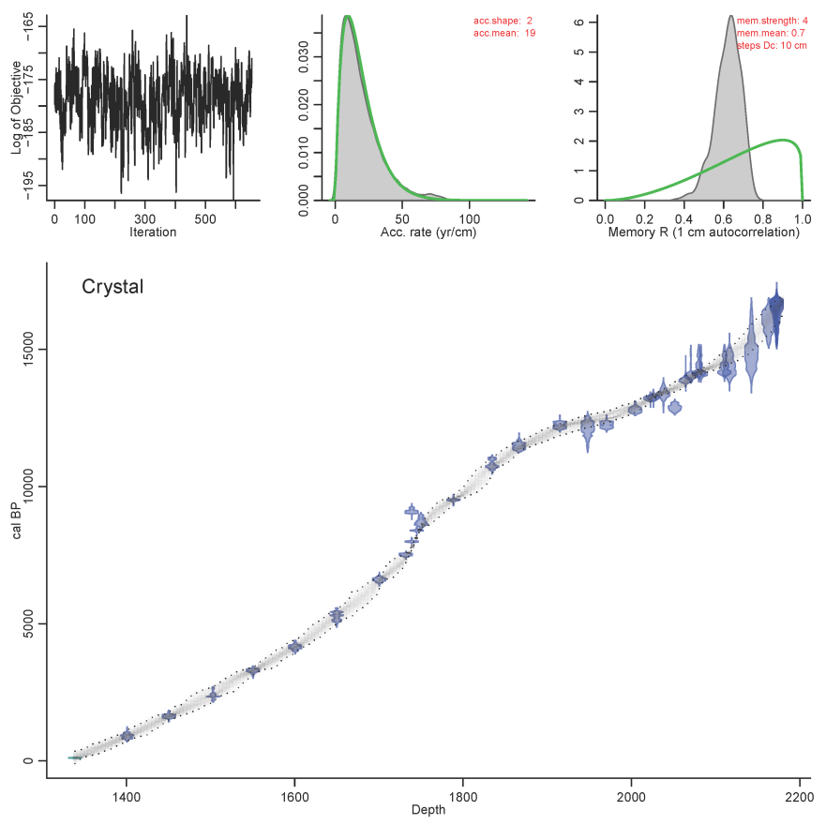
Chronologies and Age Models
An Age Model has two components:
Set of age-depth values (or analysis unit ages)
An algorithm for interpolating ages to analysis units between the ones with independent ages.
Bacon

Slide 30
Chronologies and Age Models
An Age Model has two components:
Set of age-depth values (or analysis unit ages)
An algorithm for interpolating ages to analysis units between the ones with independent ages.
A Chronology is a set of ages assigned to analysis units.
A chronology is based on an age model.

Slide 31
Geochronology
Geochronology
GeochronTypes
GeochronD
SampleID
GeochronTypeID
AgeTypeID
Age
ErrorOlder
ErrorYounger
Infinite
Delta13C
LabNumber
MaterialDated
Notes
GeochronTypeID
GeochronType
Amino acid racemization
Carbon-14
Cosmogenic
Electron spin resonance
Fission track
Potassium-argon
Optically stimulated luminescence
Lead-210
Silicon-32
Thermoluminescence
Uranium series
Carbon-14: accelerator mass spectrometry
Carbon-14: proportional gas counting
Carbon-14: liquid scintillation
Carbon-14: conventional radiometric
Argon-argon
Protactinium-231
Archaeomagnetic
Obsidian hydration
Paleomagnetic
Dendrochronological

Slide 32
Chronologies
CollectionUnits
Chronologies
ChronControls
CollectionUnitID
SiteID
CollTypeID
DepEnvtID
Handle
CollUnitName
CollDate
CollDevice
GPSLatitude
GPSLongitude
GPSError
WaterDepth
Location
Notes
ChronologyID
CollectionUnitID
AgeTypeID
ContactID
IsDefault
ChronologyName
DatePrepared
AgeModel
AgeBoundYounger
AgeBoundOlder
Notes
ChronControlID
ChronologyID
ChronControlTypeID
Depth
Thickness
Age
AgeLimitYounger
AgeLimitOlder
Notes

Slide 33
Chronology Controls
ChronControls
ChronControlTypes
ChronControlID
ChronologyID
ChronControlTypeID
Depth
Thickness
Age
AgeLimitYounger
AgeLimitOlder
Notes
ChronControlTypeID
ChronControlType
HigherChronControlTypeID
Geochronologic
Relative time scale
Stratigraphic
Other absolute dating methods
Other dating methods
Radiocarbon
Lead-210
Thermoluminescence
Uranium-series
Argon-argon
Potassium-argon
Obsidian hydration
Amino acid racemization
Electron spin resonance
Radiocarbon, average of two or more dates
Radiocarbon, reservoir correction
Radiocarbon, calibrated
Radiocarbon, reservoir correction, calibrated
Radiocarbon, calibrated, summed probabilities

Slide 34
Chronology Controls
ChronControls
ChronControlTypes
ChronControlID
ChronologyID
ChronControlTypeID
Depth
Thickness
Age
AgeLimitYounger
AgeLimitOlder
Notes
ChronControlTypeID
ChronControlType
HigherChronControlTypeID
Geochronologic
Relative time scale
Stratigraphic
Other absolute dating methods
Other dating methods
Geologic time scale
Geomagnetic polarity time scale
Marine isotope stages
North American archaeological time scale
North American land mammal ages
Quaternary event classification
South American land mammal ages
MIS 1
MIS 2
MIS 3
MIS 4
MIS 5
MIS 5a
MIS 5b

Slide 35
Chronology Controls
ChronControls
ChronControlTypes
ChronControlID
ChronologyID
ChronControlTypeID
Depth
Thickness
Age
AgeLimitYounger
AgeLimitOlder
Notes
ChronControlTypeID
ChronControlType
HigherChronControlTypeID
Geochronologic
Relative time scale
Stratigraphic
Other absolute dating methods
Other dating methods
C1n/C1r (Brunhes/Matuyama)
C1r.1r/C1r.1n (Jaramillo top)
C1r.1n/C1r.2r (Jaramillo bottom)
C1r.2r/C1r.2n (Cobb Mountain top)
C1r.2n/C1r.3r (Cobb Mountain bottom)
C1r.3r/C2n (Olduvai top)
C2n/C2r.1r (Olduvai bottom)
Biostratigraphic
Event stratigraphic
Sediment stratigraphic
Blytt-Sernander boundary
Geologic time-scale boundary
Geomagnetic polarity reversal
Tephra

Slide 36
Chronology Controls
China Hat
Eldgjá
Glen Garry
Hekla 1
Hekla 1104
Hekla 1693
Hekla 4
Katla 1721
Katla 1918
Katla ~1500
Laacher See
Landnám
Lava Creek
Mazama
Saksunarvatn
67000 – 55500
1016 – 1012
2210 – 1966
846
846
257
4300 – 4220
229
32
465 – 435
13058 – 12914
1079 – 1073
635000 – 643000
7777 – 7477
10300 – 10060
ChronControls
ChronControlTypes
ChronControlID
ChronologyID
ChronControlTypeID
Depth
Thickness
Age
AgeLimitYounger
AgeLimitOlder
Notes
ChronControlTypeID
ChronControlType
HigherChronControlTypeID
Geochronologic
Relative time scale
Stratigraphic
Other absolute dating methods
Other dating methods
Biostratigraphic
Event stratigraphic
Sediment stratigraphic
Blytt-Sernander boundary
Geologic time-scale boundary
Geomagnetic polarity reversal
Tephra

